Slide 1
Predicting segmentation of Hotstar Users
Presented by: Team-1

Slide 2

Agenda for the day
Problem Statement
Understanding the dataset
Data Preprocessing
Feature Engineering and Exploratory Data Analysis
Feature Selection
Application of ML models
Hyper-parameter Tuning and selection of best model

Slide 3
Defining the problem statement
Using the demographic data of Hotstar users, predict whether the user will show positive or negative interest
About the data
Dataset comprises of:
Demographic Details include:
Test Data- 1L line items
Training Data- 2L line items
Cities
Day of week (1-7)
Genres (Drama, cricket etc.)
Titles of programs watched
Time of day when the programs were watched (0-24 hours)
Segment (positive or negative)

Slide 4
Data Preprocessing
Cities and genres were present in the format- “ABC:123, XYZ:456”
Day of week and time of day were in the format- “2:34” and “15:34” respectively
These features were split and unique lists were made for each of them. Following were the observations:
Cities
Genres
Day of week
Time of Day
1358
35
1-7
0-23
The target variable “segment” was encoded as 1 (Pos) and 0 (Neg).

Slide 5
Feature Engineering
The unique feature lists were transformed into new features as follows:
1358 Cities
Metro
35 Genres
15 different sports were clubbed into “Sports”
24 Hours of day
24 hours were divided into four quarters of equal width
7 Days of week
1-5 were considered as Monday to Friday and labelled as “Weekday”
Thus, we are left with 21 Genres
6 and 7 were clubbed as “Weekend”
Non-Metro
For application of models, we take into account 29 features and a target variable “segment”.

Slide 6
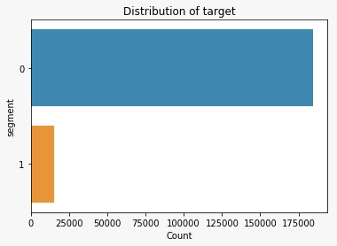
Exploratory Data Analysis (1/3)
Positive-184745 Lines
Negative-15255 Lines

Slide 7
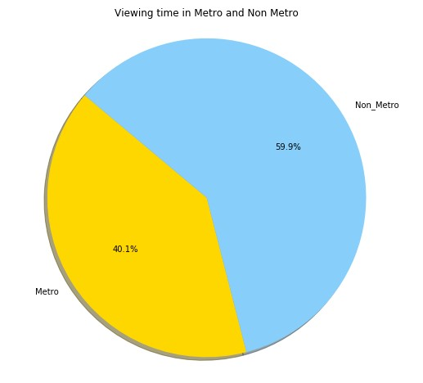
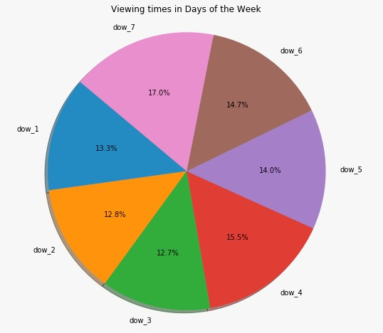
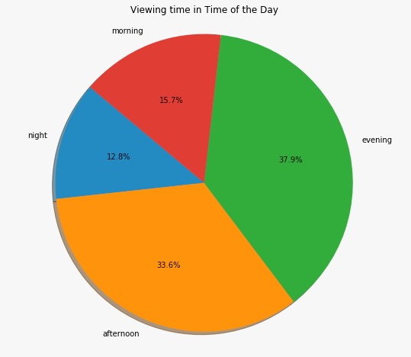
Exploratory Data Analysis (2/3)

Slide 8
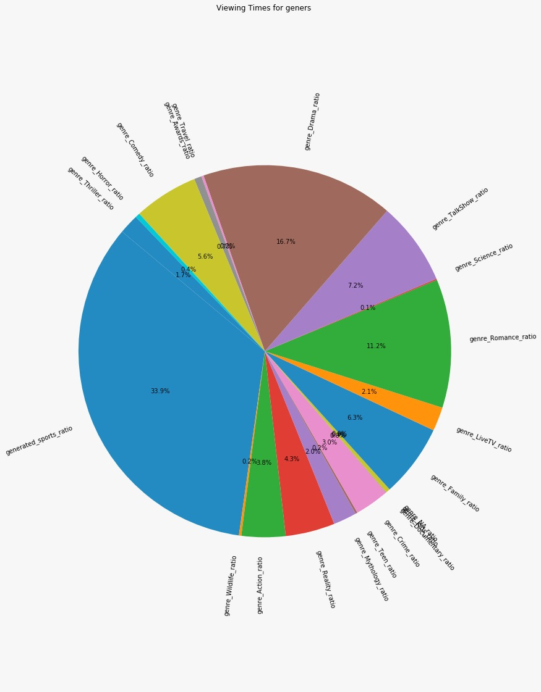
Exploratory Data Analysis (3/3)

Slide 9
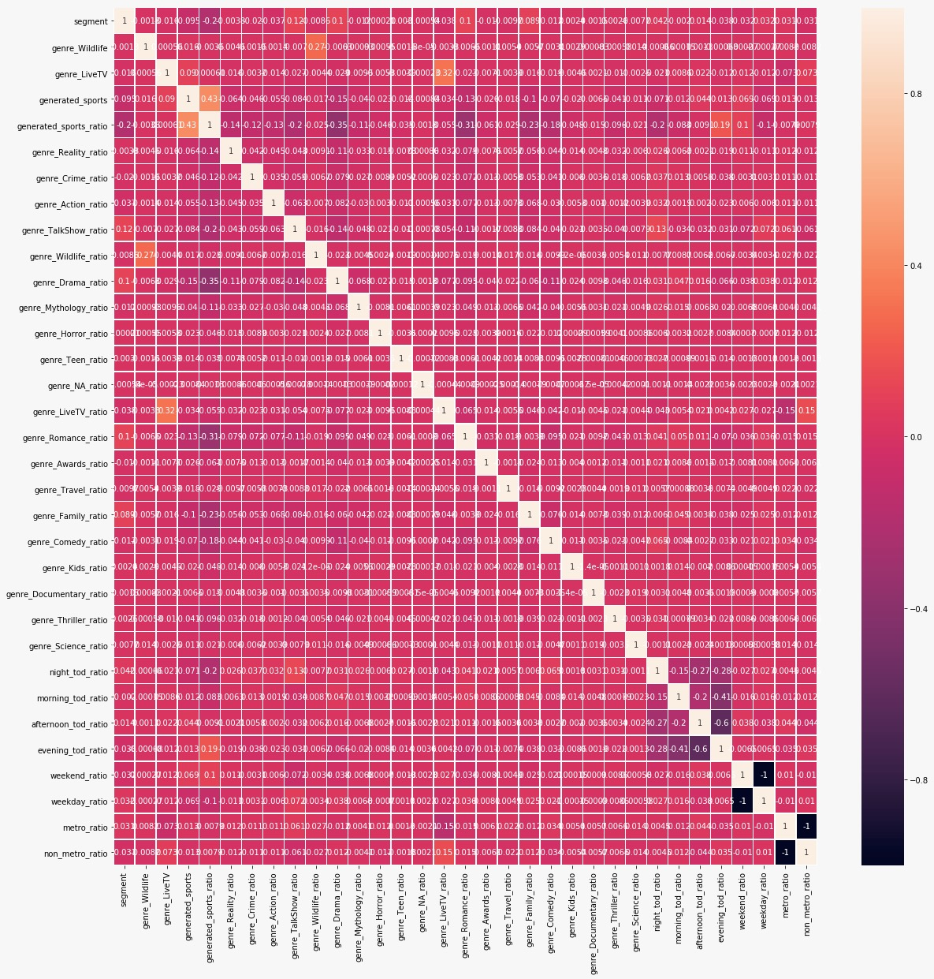
Feature Selection and ML Models
No correlations were present amongst the 30 features
Hence, it’s a classification problem.
We have applied:
K-Means Clustering
Naïve-Bayes
Decision-Tree
XGBoost Model

Slide 10
K-Means Clustering
Approach | Accuracy | ROC-AUC
With SMOTE | 0.56765 | 0.5287
Without SMOTE | 0.569175 | 0.530
Target Variable | Precision | Recall | F1-Score | Support
0 | 0.93 | 0.57 | 0.71 | 36949
1 | 0.09 | 0.48 | 0.15 | 3051
 | 0.87 | 0.57 | 0.67 | 40000

Slide 11
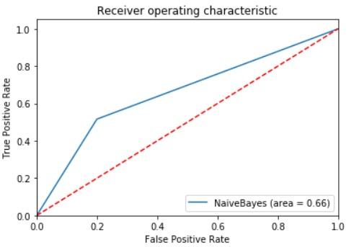
Naive-Bayes Algorithm
Accuracy of the model is : 0.7786166666666666
AUC_ROC Score is: 0.6582665729311108

Slide 12
Decision Tree
The ROC-AUC score is: 0.4998
Target Variable | Precision | Recall | F1-Score | Support
0 | 0.91 | 0.42 | 0.58 | 36949
1 | 0.07 | 0.52 | 0.12 | 3051
 | 0.85 | 0.43 | 0.54 | 40000

Slide 13
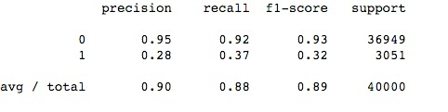
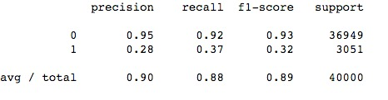
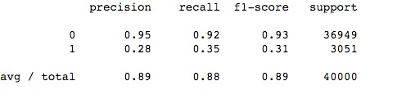
XG Boost on Dataset (Without Sampling)
train-auc:0.814474 validation-auc:0.806461
AUC_ROC Score is:0.7978
train-auc:0.828939 validation-auc:0.808176
AUC_ROC Score is:0.8262
train-auc:0.814474 validation-auc:0.806461
AUC_ROC Score is:0.8162

Slide 14
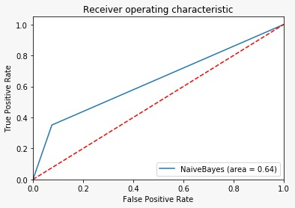
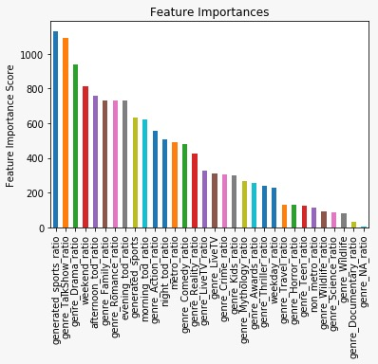
XG Boost on Dataset (Without Sampling)
Total AUC Score of our final model is 0.8131 on testset
Hence, our best model is with max-depth=5 using the GridSearch.

Slide 15
Scope for further improvement
EDA can be done in a more detailed fashion
Feature Engineering can be improved by including “Title” as well
The present XGBoost model hyper-parameters can be tuned for better results
Combination of more models can be applied.

Slide 16
THANK YOU!

